Slide 1
SUGUMAR R
au412721205048
3/21/2024 Annual Review

Slide 2
PROJECT TITLE
FACE MASK DETECTION

Slide 3

AGENDA
Project goals and the significance of face mask detection in public health and safety.
Strategies for gathering a diverse dataset of images with individuals wearing and not wearing masks.
It helps to identify whether the people is wearing mask or not in the hospitals.

Slide 4
PROBLEM STATEMENT
Develop an AI-powered system capable of accurately detecting whether individuals in images or video streams are wearing face masks or not. The system should provide real-time detection and classification, contributing to public health measures by enabling automated monitoring and enforcement of face mask usage in various environments, such as public transportation, workplaces, and retail establishments.

Slide 5
PROJECT OVERVIEW
In recent times, the global emphasis on public health and safety has significantly increased, prompting the need for innovative solutions to enforce preventive measures effectively. Face masks have become a crucial tool in mitigating the spread of contagious diseases, including COVID-19. However, ensuring compliance with mask-wearing mandates in public spaces presents a significant challenge.
The Face Mask Detection project aims to address this challenge by leveraging artificial intelligence (AI) to develop a robust system capable of automatically detecting the presence or absence of face masks on individuals within images or video streams. By implementing advanced computer vision techniques and machine learning algorithms, the system will enable real-time identification of mask-wearing behavior, facilitating proactive enforcement of mask mandates.

Slide 6

WHO ARE THE END USERS?
Public Health Authorities
Business Owners and Managers
Transportation Authorities
Workplace Managers
Educational Institutions
Security and Surveillance Companies
Healthcare Facilities
Event Organizers
Individual Consumers
3/21/2024 Annual Review

Slide 7
YOUR SOLUTION AND ITS VALUE PROPOSITION
Our solution for face mask detection is designed to provide a reliable and efficient method for automatically identifying individuals wearing face masks in images or video streams. Leveraging state-of-the-art artificial intelligence and computer vision techniques, our solution aims to contribute to public health efforts by facilitating the enforcement of mask-wearing mandates in various environments.

Slide 8
THE WOW IN YOUR SOLUTION
Comprehensive Approach: Your solution covers all key components of a face mask detection system, from data collection and preprocessing to model training, deployment, and user interface development.
Innovative Technology: Your use of advanced artificial intelligence and computer vision techniques, such as deep learning models and real-time processing, demonstrates a cutting-edge approach to solving the problem.
Practical Application: The practical application of your solution in various environments, such as public transportation, workplaces, and healthcare facilities, shows its relevance and potential impact on public health and safety.
8

Slide 9
MODELLING
Data Collection: Gather a dataset of images containing people with and without face masks. Annotate these images to indicate where the face and the mask are located (bounding box annotations).
Data Preprocessing: Resize the images to a consistent size, normalize pixel values, and preprocess them to enhance features that will help in detection.
Model Selection: Choose a suitable pre-trained CNN model for object detection. Common choices include Faster R-CNN, YOLO (You Only Look Once), and SSD (Single Shot MultiBox Detector).
Fine-tuning: Fine-tune the selected model on your dataset of images with annotated face mask regions. This involves adjusting the weights of the pre-trained model to better fit your specific task.
Training: Train the model on the annotated dataset.
9

Slide 10
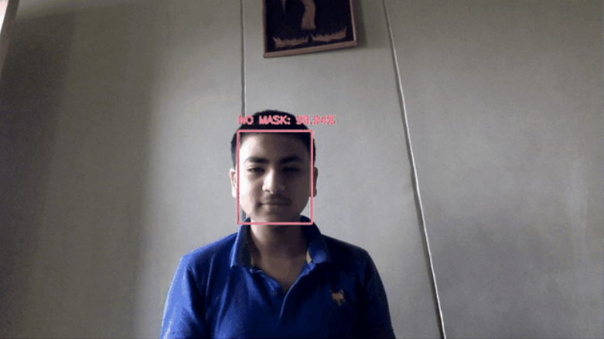
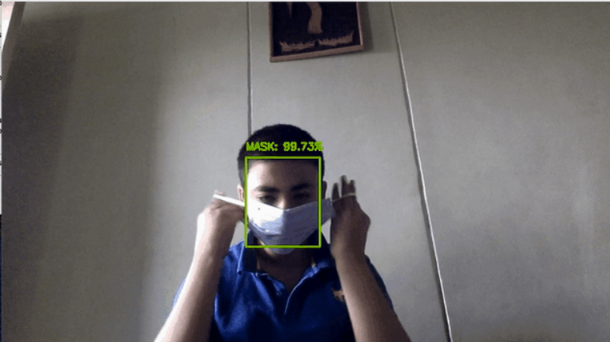
RESULTS
10

